Slide 1
TA 111: Technical Arts
2023-24 II
Lecture 19
Auxiliary Views– I
Dr. Syam Nair
Department of Civil Engineering
IIT Kanpur
Office: FB 307
Phone: 6424
Email: syamnair@iitk.ac.in

Slide 2
Reading Assignment (Mandatory): Auxiliary Views
Thomas E. French, “Engineering Drawing and Graphics Technology”
Chapter 9, Auxiliary Views: Lines and Planes Explored

Slide 3
Auxiliary Views: Remember – Principal Orthographic Views
H
F
P

Slide 4

Auxiliary Views Concept

Slide 5
Auxiliary Views Concept
H
F
A2
A1
F
F
Note: Partial information is given in Auxiliary Views

Slide 6
Auxiliary Views Concept
Auxiliary views are used:
  To find the true size and shape of a surface that is not parallel to principal planes of projection
  To find orthographic views of an object whose side is not parallel to principal planes of projection
Theories employed from
  Orthographic projection
  Space geometry

Slide 7
Auxiliary Views …
Primary Auxiliary View is the one which is taken from one of the principal planes of projection
A primary auxiliary view can be one of the three types
  Adjacent to Horizontal/Top view,
  Adjacent to Frontal, or
  Adjacent to Profile
A secondary auxiliary view is the one which is taken from a primary auxiliary view
  Principles of drawing a secondary auxiliary view are same as that for a primary auxiliary view

Slide 8
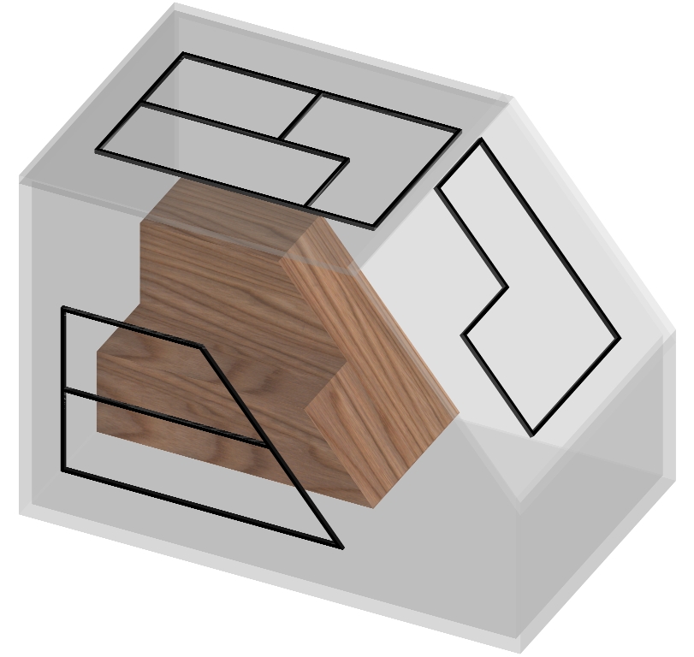
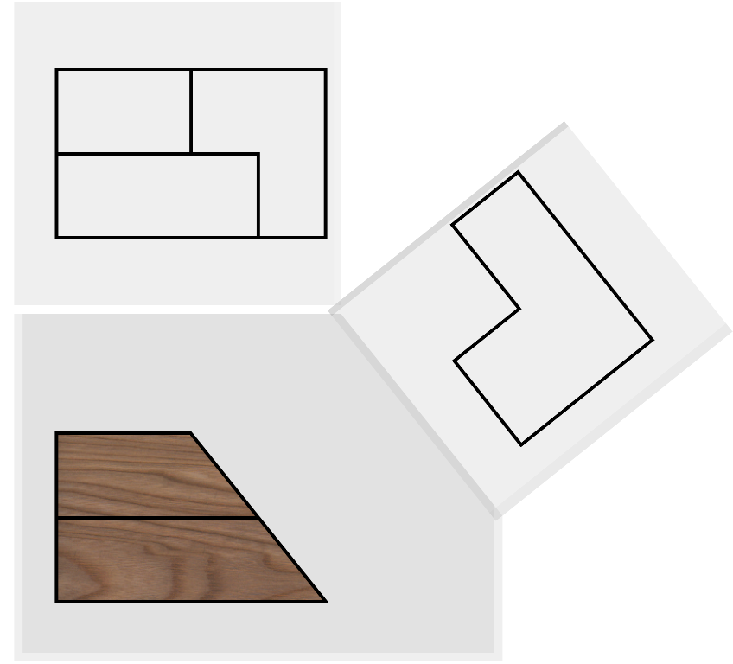
Auxiliary Box
H
F
A1
F

Slide 9
Construction of Auxiliary Views
Draw the principal views
Draw a hinge line (e.g. F-A1, H-A1, P-A1)
Draw the projectors into auxiliary view (A1)
Transfer the distances (as you did in space geometry)
Complete the auxiliary view (in A1 or A2)

Slide 10
Construction of Auxiliary Views: Steps
To get the TS of an oblique surface in an auxiliary view, an EV of the oblique surface is needed
For this, a line in TL is needed which is common in the oblique surface and a principal orthographic plane
Once a line in TL is available in F, H, or P plane, its PV can be obtained and the oblique plane will then be in EV
Alternate reference line – to transfer distances: Sometimes, a reference line (or plane) parallel to hinge line (or H plane) may be used (instead of the hinge line itself) to transfer distances and draw auxiliary views
Which is the line in TL common to oblique plane and principal plane?

Slide 11
Construction of Auxiliary Views
D
C
Oblique view of ABCD
D
A
TRUE SHAPE of ABCD
C
B
D
A
B
H
F
C
Find True Shape of the oblique plane ABCD
A
F
P
D
B
A
D
A
A1
Oblique view of ABCD
F
EV of plane ABCD
C
B
C
B

Slide 12
Simple Problem of Oblique Surface
B,C
EV
1
D,A
1
2
H
D
C
C
TL
TL
B
A
D
H
B
Normal View
(True Shape)
F
A
D
A
Find the line in TL in HV common to oblique plane and principal plane?
B
C

Slide 13
Example 1
Consider the truncated pyramid, find Normal View of the oblique top surface
Identify the line on oblique surface which is in TL in top view
Draw hinge line perpendicular to the TL
Obtain EV of the oblique surface in Auxiliary plane R1
Note that a Reference Plane (R1′) is used instead of the hinge line H-F
Similarly, a Reference Plane (R2′) is used instead of the hinge line H-R1
True surface is obtained in plane R2
True Surface
d1
R1
d
4
4
H
R1
R2
d1
5
R1,
3
R1
5
3
R2
EV
R2
R2′
4
H
3
H
1
R1,
2
R1
1
R2
2
R2
H'
5
H
2
H
R1
R2
1
H
TL₁₂
H
F
d
4
H
5
H
3
H
Reference plane R1′
1
H
2
H

Slide 14
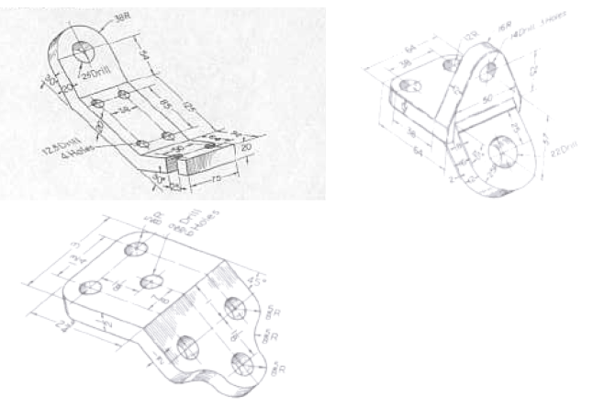
Auxiliary Views of Oblique Surface
Surface does not appear as an edge view in H/F/P views

Slide 15
Drawing a Machine Part with an Oblique Surface

Slide 16
Normal views of oblique surfaces and construction of Front and Top views
Center Plane
Reference
Plane No.1

Slide 17

A
Center Plane
CL
B
Reference
Plane No.1
RP - I
RP - I
Complete Orthographic Projections to the extent you can do
Look for a line in TL and is common/intersection of oblique and other plane
It is line AB – get the point view of AB so to get EV of planes
Locate RP1 and convenient place so that ……

Slide 18
Center Plane
A
CL
Reference
Plane No.1
CL
B
B-A
B
A
RP-I
RP-I

Slide 19
On back face
On front face
P_{I}
CL
S_{I}
S
P
CL
P.P_{I}
P
P_{I}
S
S_{I}
RP-I
P_{I}
P
RP-I

Slide 20
Center Plane
CL
Reference
Plane No.1
CL
RP-I
RP-I
Concluding:
From True shape of Oblique Surface and concepts of auxiliary plane,
We created front and top view of oblique surface.

Slide 21
Thank You !!!

